Slide 1

Employee Demographic Case Study
Isaac Ng Sheng

Slide 2
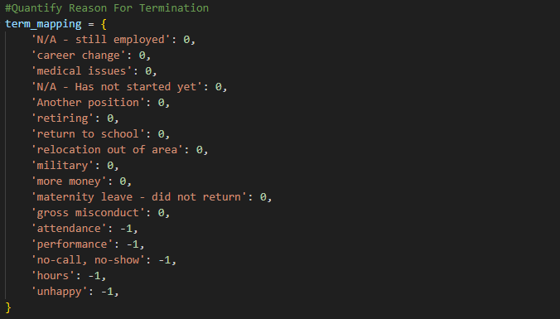
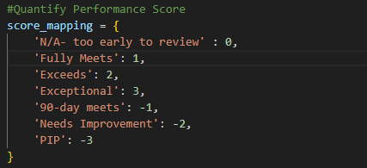
Quantifying Qualitative Factors
Performance Score
Provided values based on the degree of severity of the performance score
Reason For Termination
Pseudo-binary values provided with neutrals being awarded 0 while values that could allude to a poor reflection on the manager/company being awarded -1

Slide 3
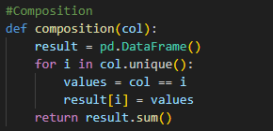
Q1:What are the key employee characteristics and demographic factors to take note of, and are there any trends to highlight?
Analysing through Feature Value Composition

Slide 4
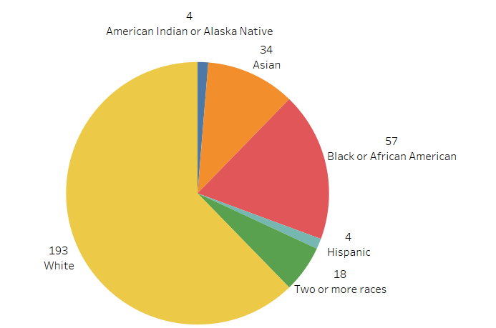
Q1:What are the key employee characteristics and demographic factors to take note of, and are there any trends to highlight?
Race
Results show whites being 193/310 of the employees, making up 62.3% of the composition, with the next largest being blacks, at 57/310 = 18.4%
Granted those numbers are the general expected numbers, and thus does not raise any concerns. With preliminary research showing that about 59.3% of US Citizens being White.
Source: https://en.wikipedia.org/wiki/Race_and_ethnicity_in_the_United_States

Slide 5
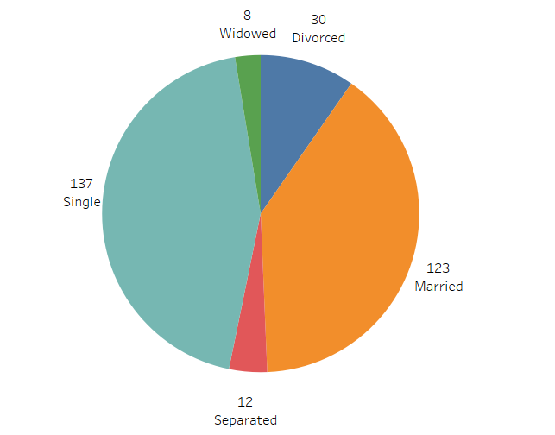
Q1:What are the key employee characteristics and demographic factors to take note of, and are there any trends to highlight?
Marital Status
Results show that Singles take on 137/310 of the employees, being 44.2% of the composition, with the next largest being married couples at 123/310 = 39.7%
Granted those numbers are the general expected numbers, and thus does not raise any concerns. With preliminary research showing that about 42% of US Citizens being Single.
Source: https://www.census.gov/newsroom/stories/unmarried-single-americans-week.html#:~:text=From%20nationalsinglesday.us%2C%20%E2%80%9CDid,those%20who%20have%20never%20married.

Slide 6
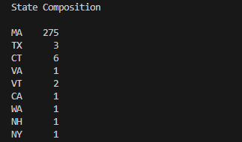
Q1:What are the key employee characteristics and demographic factors to take note of, and are there any trends to highlight?
State
Results shows an overwhelming number of employees coming from the MA state, being 275/310 = 85.5%.
This shows that the company is likely to have more on-site employees than remote employees, having a large majority coming from the same state.
Results continue with all other states being a value of 1 (long-tail)

Slide 7
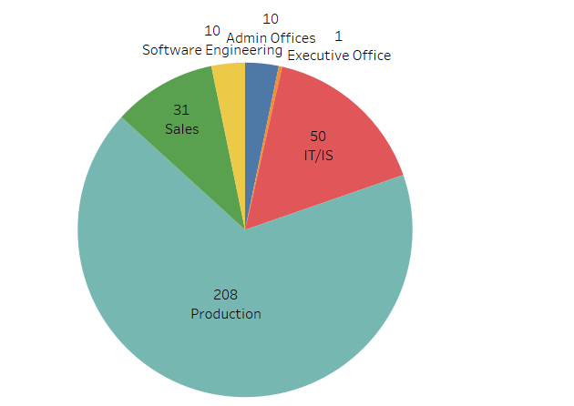
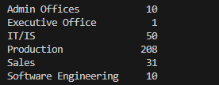
Q1:What are the key employee characteristics and demographic factors to take note of, and are there any trends to highlight?
Department
Results show a majority of employees being in the Production Department, at 208/310 = 67.1%
This shows that the company is likely to be rather Brick and Mortar, requiring significant on-site physical work.

Slide 8
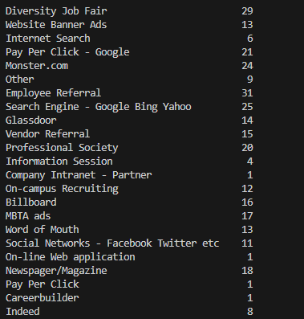
Q1:What are the key employee characteristics and demographic factors to take note of, and are there any trends to highlight?
Employee Source
Results provide an even spread across multiple sources, with the most being Employee Referral at 31/310 = 10%, and the next largest being Diversity Job Fair at 29/319 = 9.35%.

Slide 9
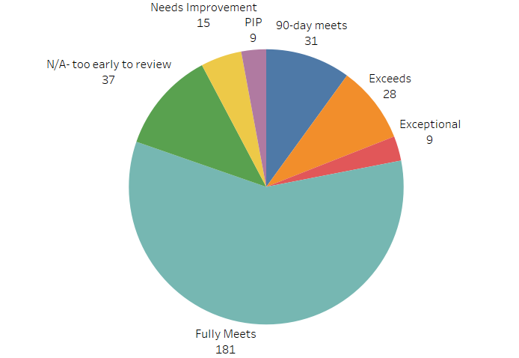
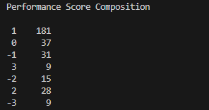
Q1:What are the key employee characteristics and demographic factors to take note of, and are there any trends to highlight?
Performance Score
Results show Information session is the highest performance score on average, granted the standard deviation is relatively low, the statistics makes sense as those who're passionate enough to go for information sessions tend to be more interested in their work
This leads to a form of selection bias for their higher categorical performance score

Slide 10
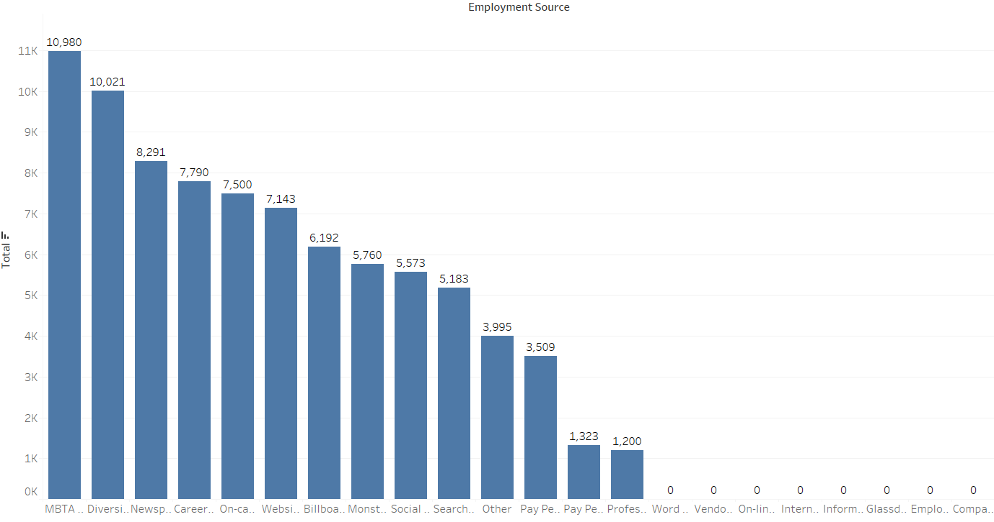
Q2 What are the best recruitment sources for this company to use?
First, comparing recruitment cost for each source with the percentage that are recruited
This shows that Certain Sources Require $0 in Cost
These sources will be prioritized, having the greatest potential with little to no opportunity cost
Sources include Company Intranet – Partner, Employee Referral

Slide 11
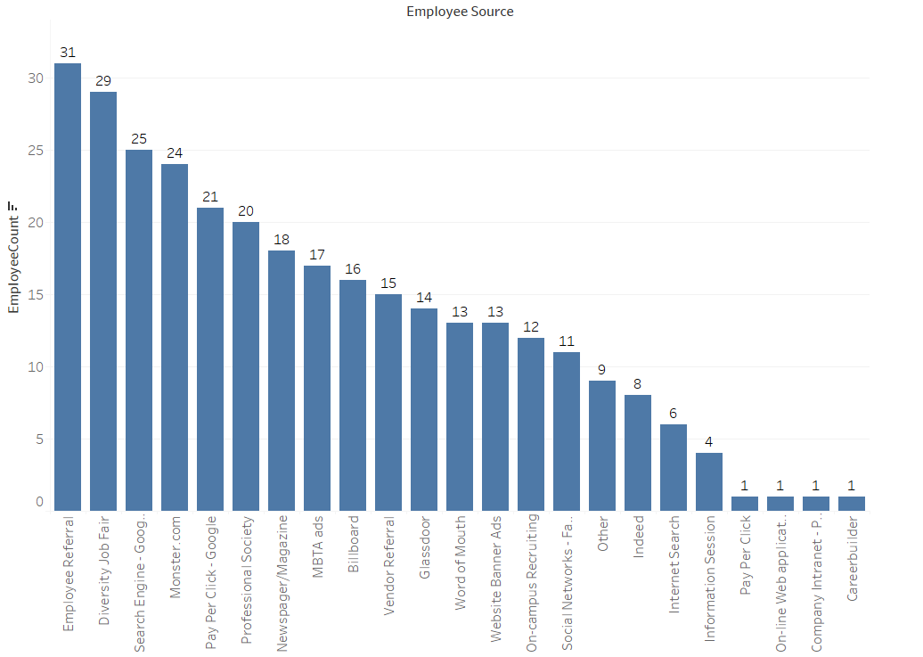
Q2 What are the best recruitment sources for this company to use?
Sorting based on total number of employees shows that Employee Referral is the only $0 cost Employee Source that has a large number of employees
With the next highest number of employees being Vendor Referral and Glassdoor.
The best recruitment source for this company to use would then be Employee Referrals. However it isn't sustainable and may breed a certain stagnant culture.
Considering the next highest number of employees being Diversity Job Fairs being significantly higher than Search Engines and Monster.com
I would prioritize search engines or monster.com as the next best in order to reap as much benefit from each cost.
However, it still is good to have diversity within the company, so although I would deprioritize diversity job fairs, I would mostly use it if the race/gender composition of the company isn't good.

Slide 12
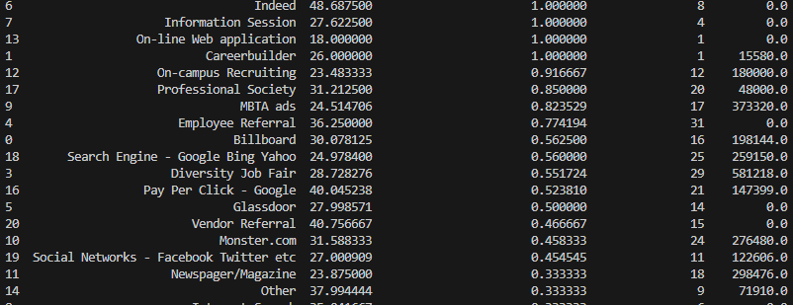
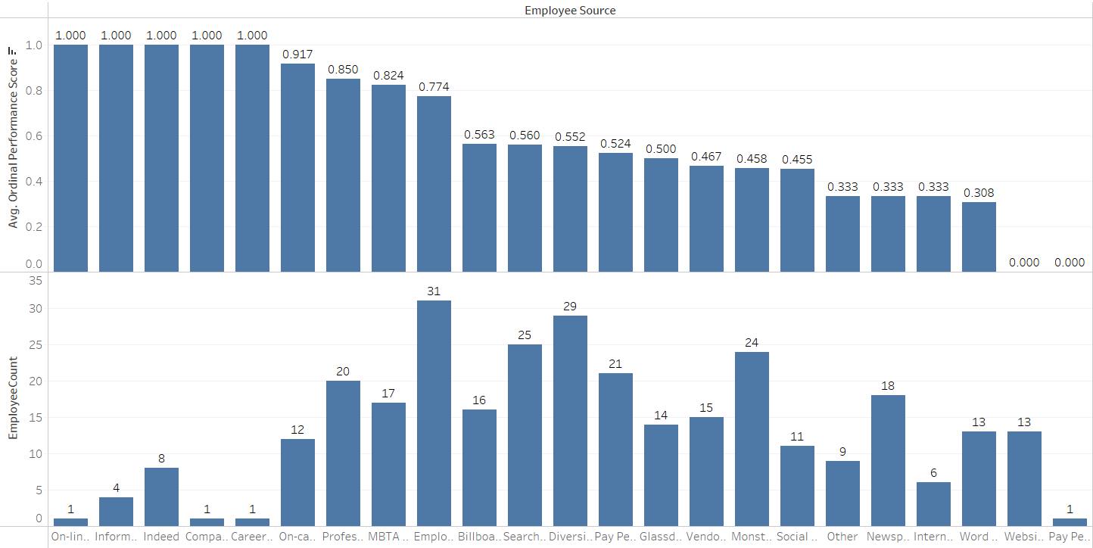
Q2 What are the best recruitment sources for this company to use?
When including performance score, I would rate information session as “the best” as they command the highest categorical performance score (with 0.0 total cost)
However, the standard deviation is low, with only 4 employees included
I would recommend looking out more for people in information sessions as there's room for expansion and hiring more, however, I would still hold employee referral generally the highest with as they're still in the top 3.
This time, I would include professional society as well, since they do have 20 employees, rather low total cost and a very good performance score

Slide 13
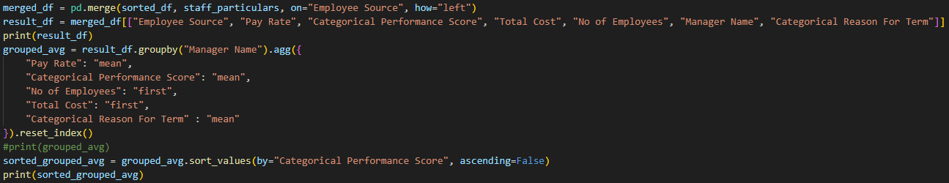
Q3 Who is the Best Manager?
Grouping based on Manager Name, I would use a similar metrics to define the best manager through performance score of their subordinates
This would lead to Eric Dougall to be the best with the highest performance score (Results shown on the next slide).
This is further supported by a low average pay rate (which saves the company money), high number of employees to show his capabilities of managing a large number, and a Reason For Termination that doesn’t contain too many unhappy individuals

Slide 14
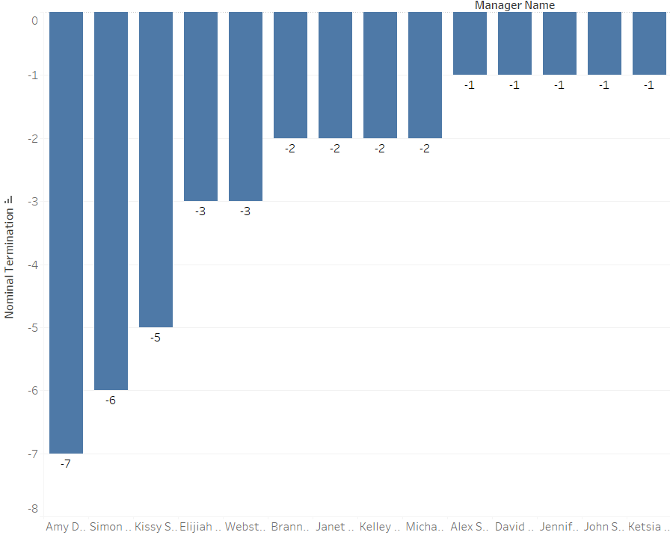
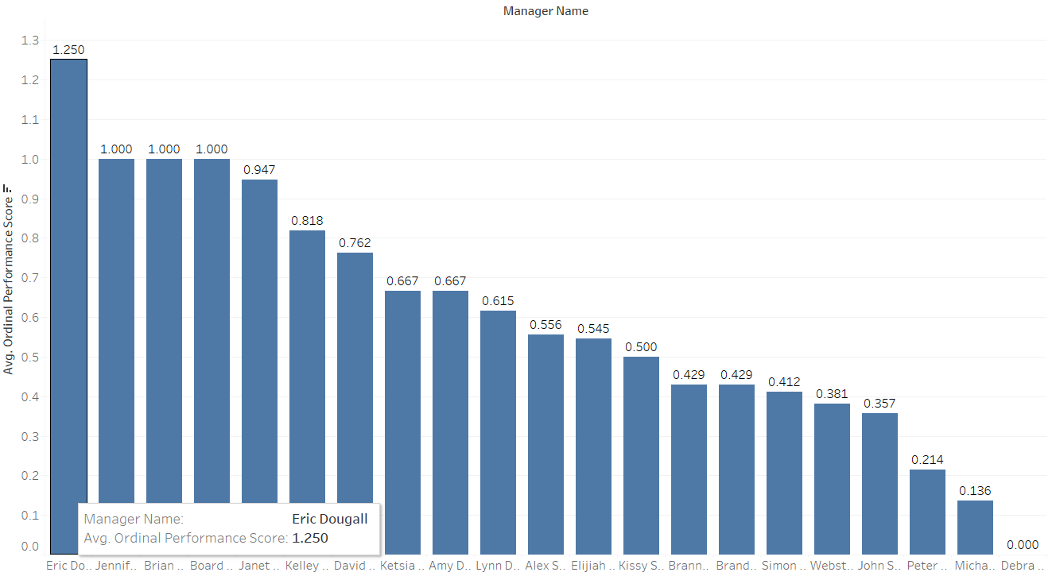
Q3a Who is a low-performing manager?
A general low-performing manager would be:
1. Those with below -0.3 Ordinal Performance Score and a Nominal Reason For Term of below -0.1
2. Those with less than -3 Nominal Termination Value

Slide 15
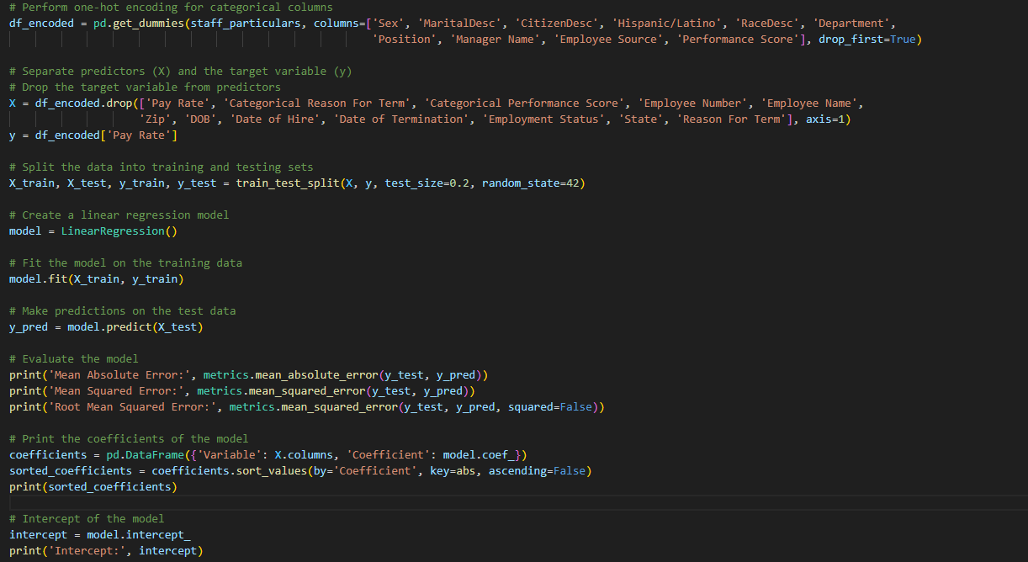
Q4 Which factors drive the pay rate the most?
Code Explanation
Applied one-hot encoding to attain dummy variables for nominal variables
Dropped irrelevant variables
Relevant variables such as “Categorical Reason for Term” has dummy variables already in place
Applied Linear Regression Model to identify factors that contribute the most to pay rate

Slide 16
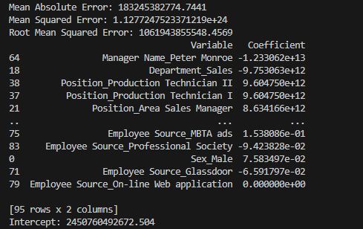
Q4 Which factors drive pay rate the most?

Slide 17

Q4 Which factors drive pay rate the most?
From the above code, having Peter Monroe as your manager significantly affects your pay rate the most, having the lowest of -1.23e+13
The next being in the sales department, providing a -9.75e+12 in pay rate.
For generalized factors, one’s Position affects employees pay rate the most
Re-running the code dropping Position would give us Hispanic/Latino as the largest coefficient, followed by various manager names.
Results of re-ran code found on the next slide
Iterating through this once more would show the departments as the largest coefficient.
Thus, the factors that drive the pay rate the most are Position, followed by Manager, and next, Department

Slide 18
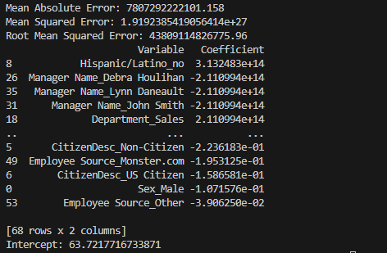
Q4 Which factors drive pay rate the most?

Slide 19
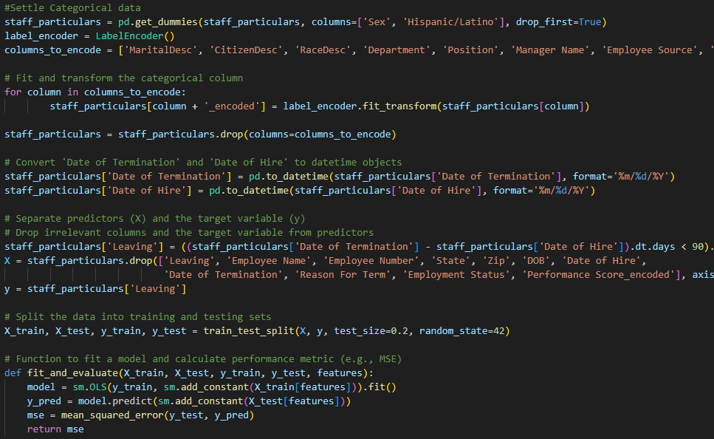
Q5 What are the characteristics and demography of employees that have a high probability of leaving the company in the next 3 Months?
Code Explanation:
Label Encoded Nominal Variables (to allow the model to recognize it)
Isolated the range between “Date of Termination” and “Date of Hire” to be 90 Days or less

Slide 20
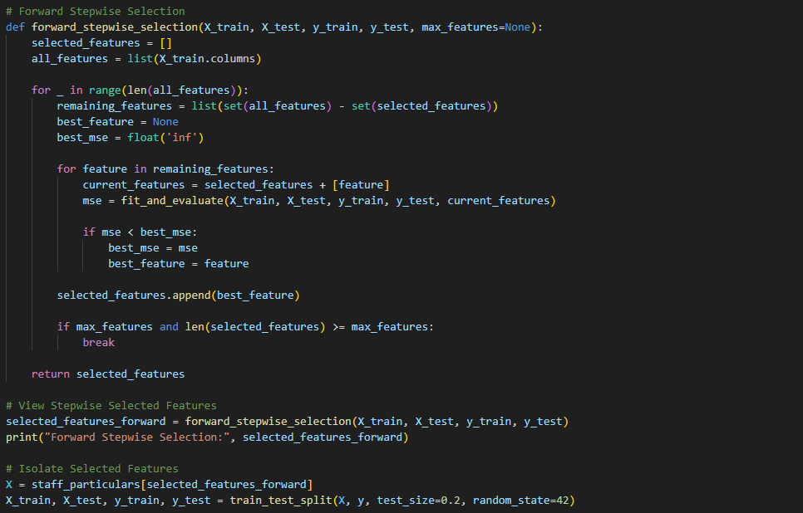
Q5 What are the characteristics and demography of employees that have a high probability of leaving the company in the next 3 Months?
Code Explanation:
Conducted Forward Stepwise Model Selection
Automated the selection of variables that largely contributes to the model
Trained the Model using the selected high-impact variables

Slide 21
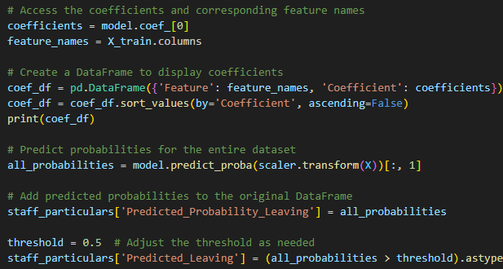
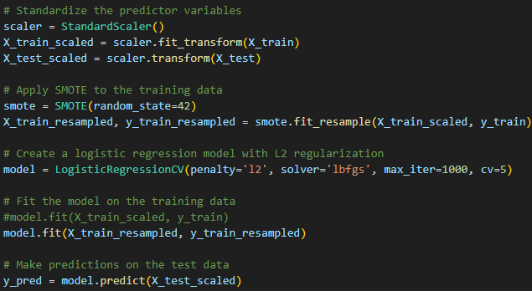
Q5 What are the characteristics and demography of employees that have a high probability of leaving the company in the next 3 Months?
Code Explanation:
Small tweaks to the output such as sorting based on highest impact on probability
Applied Logistic Regression to act as a Supervised Classification Model

Slide 22
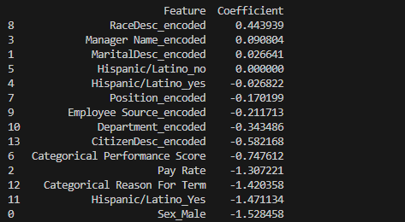
Q5 What are the characteristics and demography of employees that have a high probability of leaving the company in the next 3 Months?
The greatest contributors of a high probability of leaving the company includes
Low Pay Rate
Negative Reasons for Termination
Poor Performance Scores
Characteristics of high probability of leaving includes
Female
Non-Hispanic/Latino
US Citizenship
White

Slide 23
Thank you

